Slide 1
Unit - 5
Deep Learning

Slide 2


Gated Recurrent Unit

Slide 3
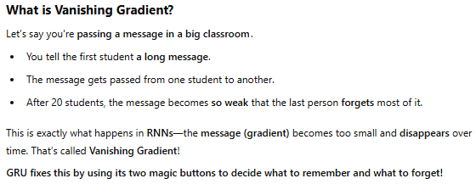


Slide 4
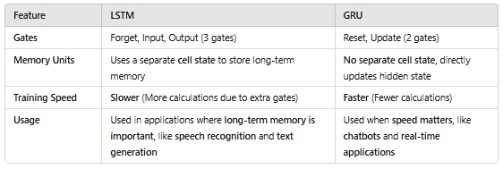
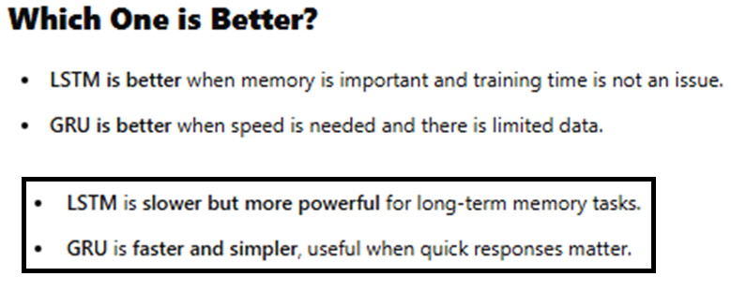

Slide 5
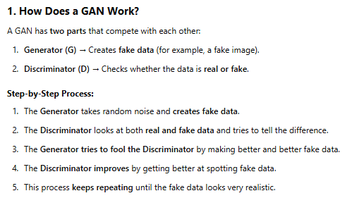
Generative Adversarial Networks

Slide 6
